Slide 1


SP3176 The Universe Chapter 4: Molecules in Space
Lim Zhi Han

Slide 2
Learning Objectives
At the end of this lesson, you should be familiar with the concept of molecular spectroscopy and how molecules are identified in space. You will be introduced to techniques and methods used to locate, identify molecules based on their fingerprints. Finally, you will have the opportunity to explore recent datasets of astrochemistry research.

Slide 3
Pre-Lecture Homework

Slide 4
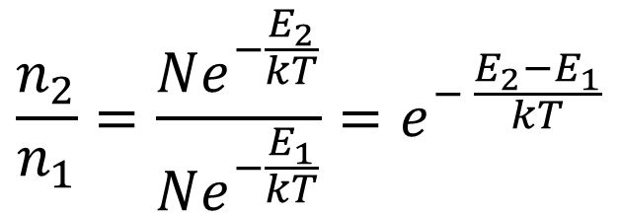
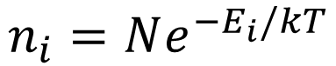
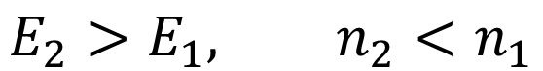
Boltzmann distribution
$$\frac{n_{2}}{n_{1}}=\frac{Ne^{−\frac{E_{2}}{kT}}}{Ne^{−\frac{E_{1}}{kT}}}=e^{− \frac{E_{2}−E_{1}}{kT}}$$
$$n_{i}=Ne^{−E_{i}/kT}$$
$$E_{2}>E_{1}, n_{2}<n_{1}$$
What does it mean: Lower energy states more populated.
Why it matters: Intensity of spectral line is population dependent.

Slide 5
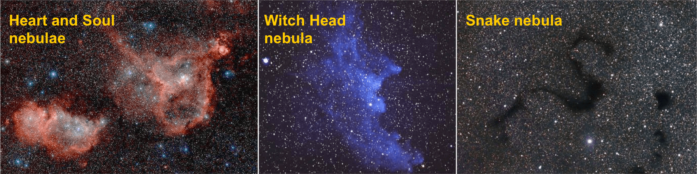
The space between stars is not empty!
Are these colours pigments of our imagination?
Why is an emission nebula red, a reflection nebula blue and a dark nebula dark?

Slide 6

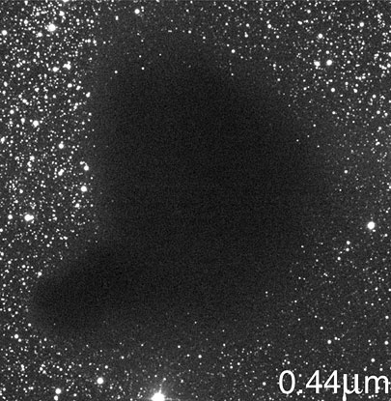
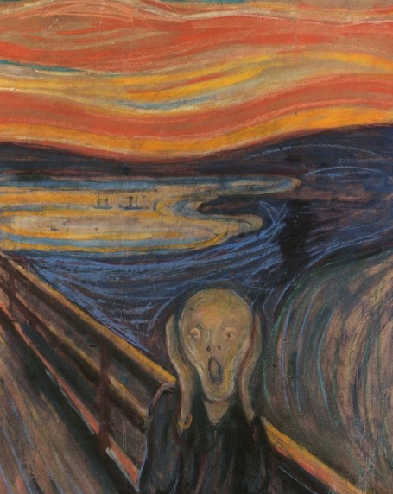
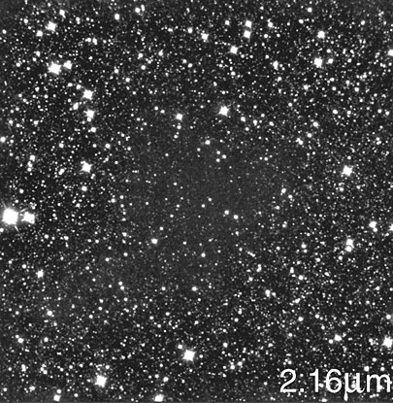
Who ate the stars?!
Bok Gobule B68
The Scream, Edvard Munch

Slide 7
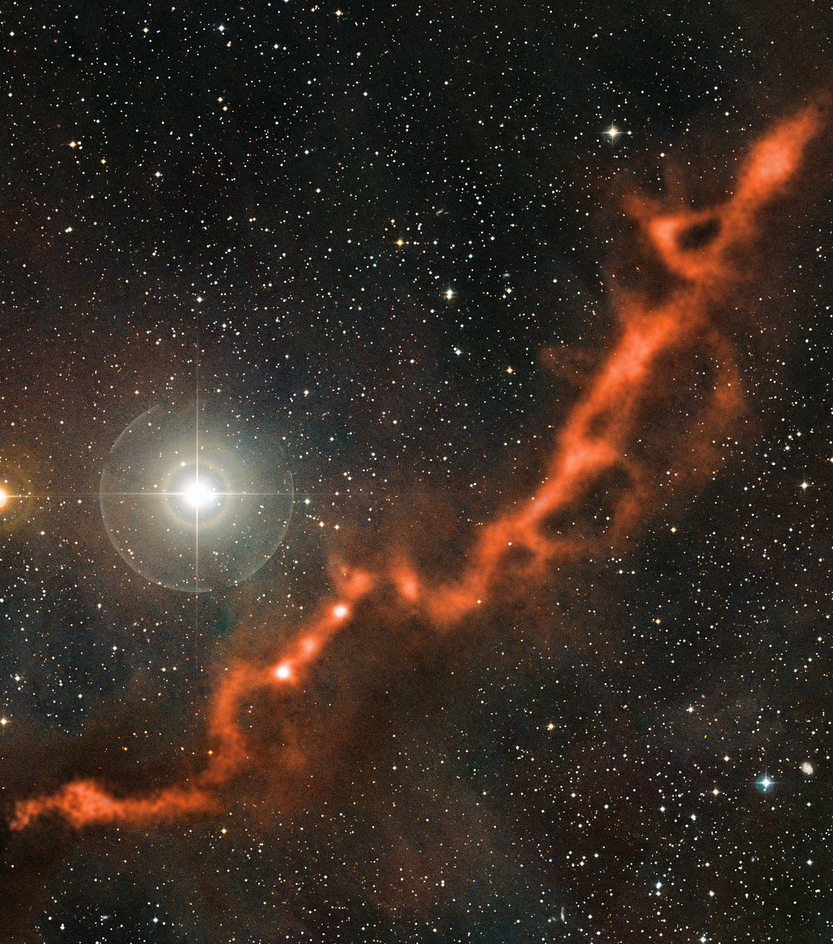
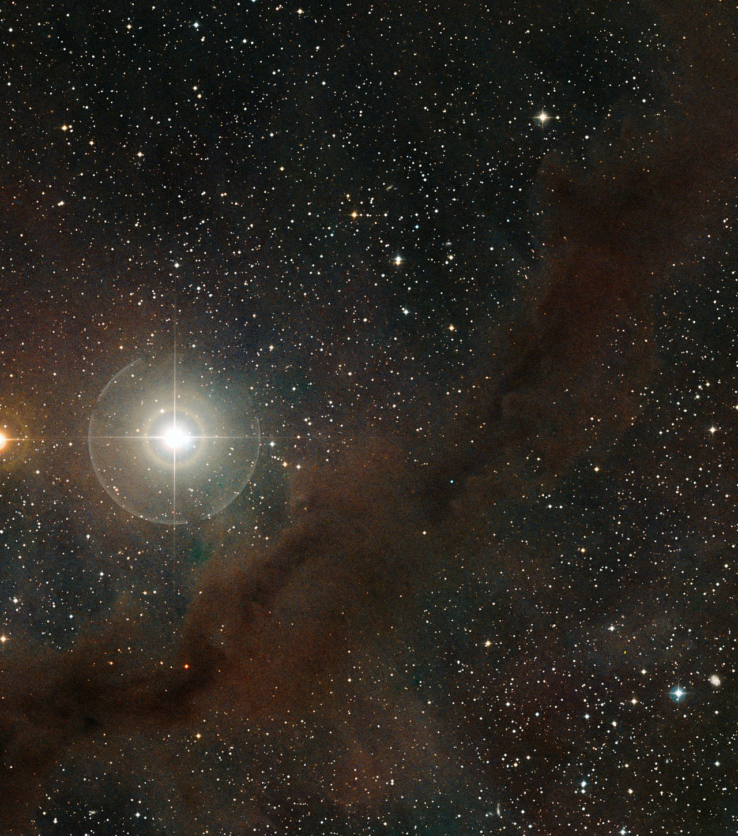
Taurus Molecular Cloud (B211 & B213) in optical light
and 2.7mm microwave light.
Image credit: ESO/APEX/A. Hacar et al./Digitized Sky Survey 2.

Slide 8
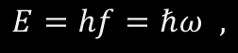

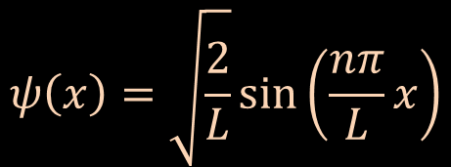

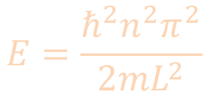
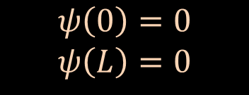
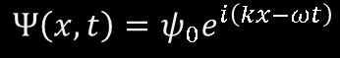
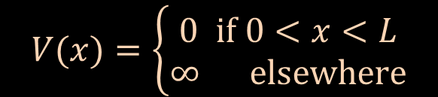
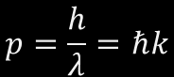
Schrödinger’s quantum model (a re-cap)
Particle-in-a-box model
Kinetic + Potential energy = Total energy
$$\frac{p^{2}}{2m}+V\left(x\right)=E$$
$$V(x)=\left\{\begin{aligned}0 if 0<x<L \\ ∞ elsewhere\end{aligned}\right.$$
Potential
Boundary Conditions
$$ψ\left(0\right)=0$$
$$ψ\left(L\right)=0$$
$$E=hf=ℏω ,$$
$$Ψ\left(x,t\right)=ψ_{0}e^{i\left(kx−ωt\right)}$$
$$p=\frac{h}{λ}=ℏk$$
$$E=\frac{ℏ^{2}n^{2}π^{2}}{2mL^{2}}$$
Allowed Energy states
Schrödinger’s eq:
$$ψ\left(x\right)=\sqrt{\frac{2}{L}}\sin\left(\frac{nπ}{L}x\right)$$
$$−\frac{ℏ^{2}}{2m}\frac{∂^{2}ψ}{∂x^{2}}+V\left(x\right)ψ\left(x\right)=E ψ(x)$$
Allowed wavefunctions

Slide 9
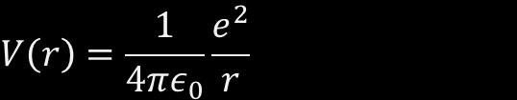
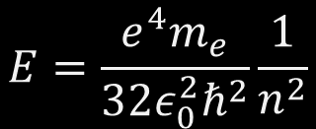
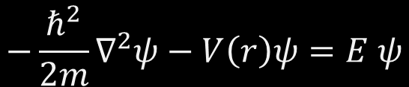

Hydrogen atom
Schrödinger’s Equation:
Potential Energy
$$V\left(r\right)=\frac{1}{4πε_{0}}\frac{e^{2}}{r}$$
$$−\frac{ℏ^{2}}{2m}∇^{2}ψ−V\left(r\right)ψ=E ψ$$
Boundary Conditions
$$ψ\left(0\right)=0$$
$$ψ\left(∞\right)=0$$
Allowed energy states:
$$E=\frac{e^{4}m_{e}}{32ε_{0}^{2}ℏ^{2}}\frac{1}{n^{2}}$$
Allowed wavefunctions:

Slide 10
How will the “quantum molecule” differ from the “quantum atom”?

Slide 11
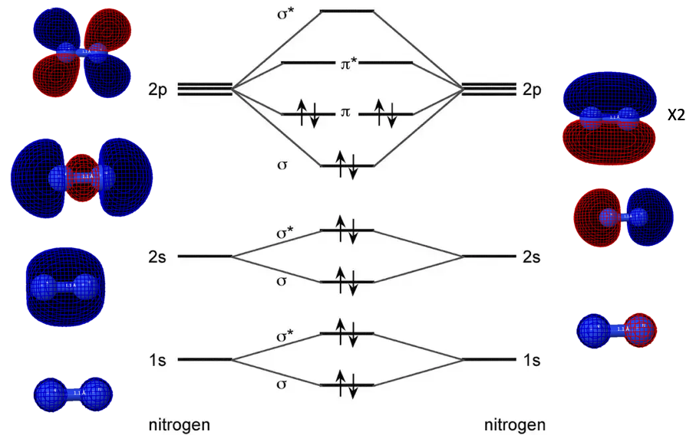

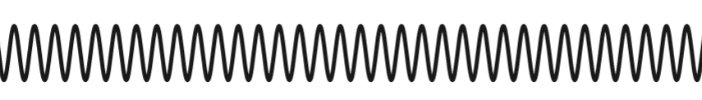
The Quantum Molecule
Electronic
Rotational
Vibrational
Central idea: In a molecule, not only electrons can move, nuclei can move too.

Slide 12
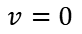
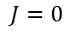

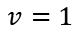



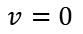


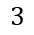
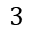




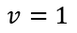
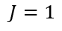
Energies of electronic, vibrational and rotational states transitions
$$⋮$$
$$⋮$$
Higher energy molecular orbital state
$$5$$
$$4$$
$$3$$
$$5$$
$$2$$
$$4$$
$$v=1$$
$$3$$
$$v=0$$
$$2$$
$$J=1$$
$$J=0$$
Rotational energy states
$$ΔE_{MO}≈{10}^{3}ΔE_{vib}≈{10}^{6}ΔE_{rot}$$
UV-vis
IR
Microwave
Vibrational energy states
$$⋮$$
Lower energy molecular orbital state
$$5$$
$$4$$
$$3$$
$$2$$
$$v=1$$
$$v=0$$

Slide 13
Born & Oppenheimer:
Nuclear and electronic motion can be studied separately
In SP3176, we’lll focus on the motion of the nuclei.
Because:
Understanding molecular orbitals is a course by itself
Astrospectroscopy identifies rotational & vibrational transitions more easily

Slide 14
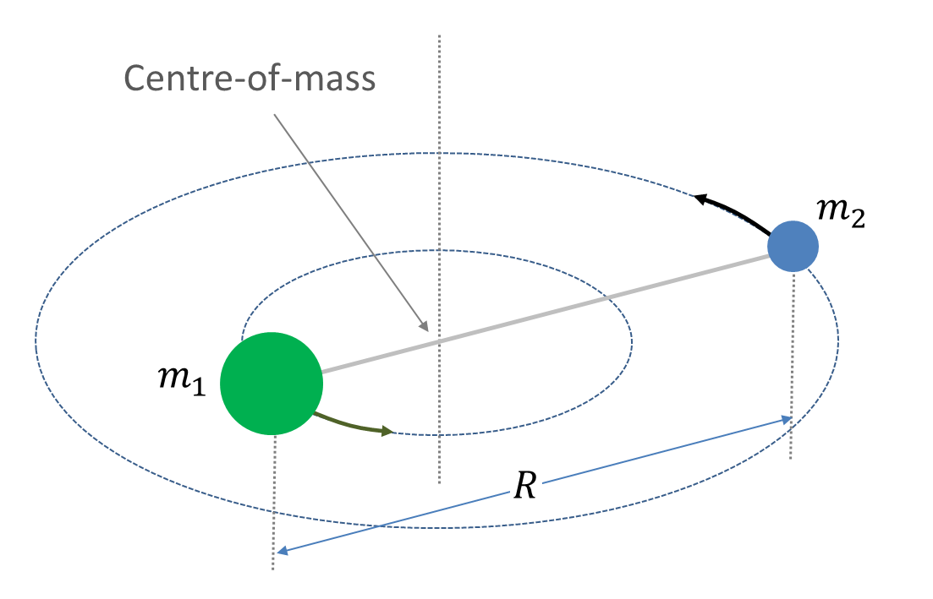
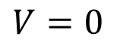
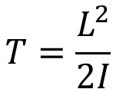
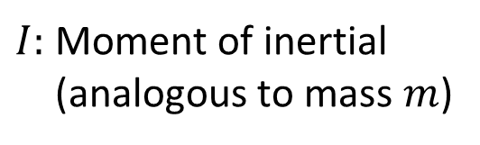
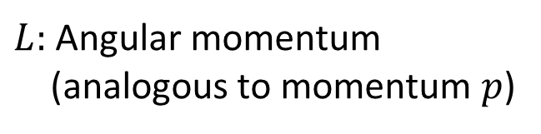
Rotation of a diatomic molecule about centre of mass
$L:$ Angular momentum
(analogous to momentum $p$)
$I:$ Moment of inertial
(analogous to mass $m$)
$$T=\frac{L^{2}}{2I}$$
Kinetic energy
Potential energy
$$V=0$$

Slide 15
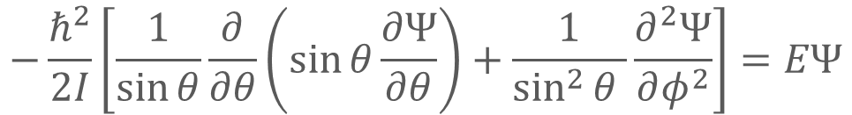
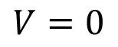
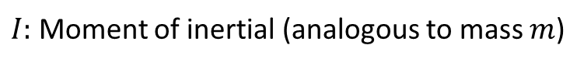
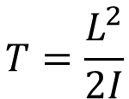
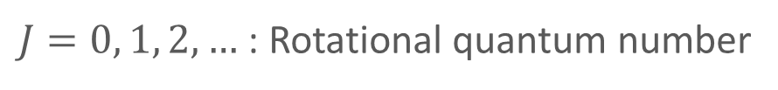
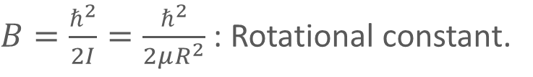
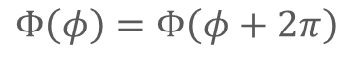
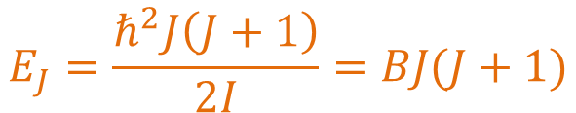
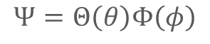
Rotation of a diatomic molecule about centre of mass
Schrodinger equation:
$$−\frac{ℏ^{2}}{2I}\left[\frac{1}{\sin{θ}}\frac{∂}{∂θ}\left(\sin{θ}\frac{∂Ψ}{∂θ}\right)+\frac{1}{\sin^{2}{θ} }\frac{∂^{2}Ψ}{∂φ^{2}}\right]=EΨ$$
$$Ψ=Θ\left(θ\right)Φ\left(φ\right)$$
Boundary cond:
$$Φ\left(φ\right)=Φ\left(φ+2π\right)$$
$$E_{J}=\frac{ℏ^{2}J\left(J+1\right)}{2I}=BJ(J+1)$$
$L:$ Angular momentum (analogous to momentum $p$)
$I:$ Moment of inertial (analogous to mass $m$)
$$T=\frac{L^{2}}{2I}$$
$J=0, 1, 2,…$ : Rotational quantum number
Kinetic energy
$B=\frac{ℏ^{2}}{2I}=\frac{ℏ^{2}}{2μR^{2}}$ : Rotational constant.
Potential energy
$$V=0$$

Slide 16
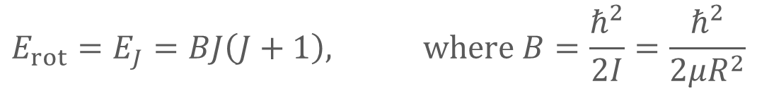

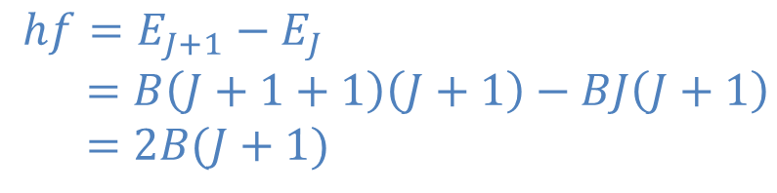
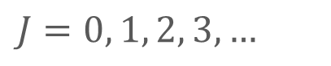
Rotation Energy Transitions
Rotational Quantum number:
$$J=0, 1, 2, 3,…$$
$$E_{rot}=E_{J}=BJ\left(J+1\right), where B=\frac{ℏ^{2}}{2I}=\frac{ℏ^{2}}{2μR^{2}}$$
Rotational Energy levels:
Selection Rule:
$$ΔJ=±1$$
Energy of photon absorbed/emitted:
$$hf=E_{J+1}−E_{J}$$ $=B\left(J+1+1\right)\left(J+1\right)−BJ\left(J+1\right)$ $$=2B(J+1)$$
Ex. Show that the rotational spectrum of a heteronuclear diatomic molecules is a set of equally spaced lines with separation $2B$.

Slide 17
Rotation Energy Transitions
Ex. Show that the rotational spectrum of a heteronuclear diatomic molecules is a set of equally spaced lines with separation $2B$.
Ex. Suppose you are given the rotational spectrum of a molecule, how does one find the internuclear distance of the molecule?

Slide 18
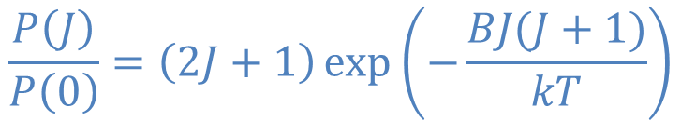
Rotation of a heteronuclear diatomic molecule
Relative intensity of the spectral lines depends on population of rotational states.
Population of rotational states depend on Temperature.
$$\frac{P\left(J\right)}{P\left(0\right)}=\left(2J+1\right)\exp\left(−\frac{BJ(J+1)}{kT}\right)$$
Degeneracy
Boltzmann factor

Slide 19
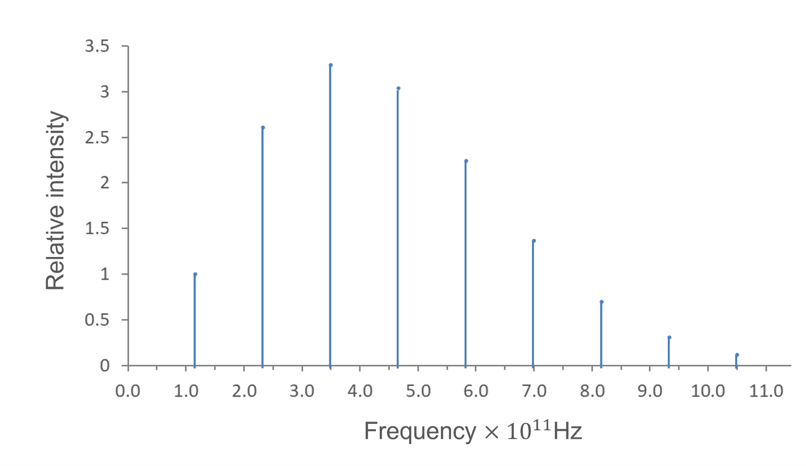
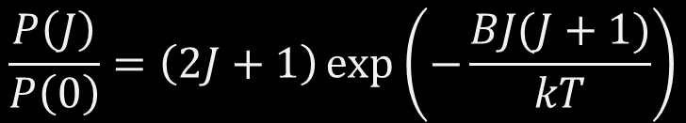
Rotation Energy Transitions
Ex. The figure below is the rotation spectrum of CO. Explain qualitatively the shape of the spectrum.
$$\frac{P\left(J\right)}{P\left(0\right)}=\left(2J+1\right)\exp\left(−\frac{BJ(J+1)}{kT}\right)$$

Slide 20
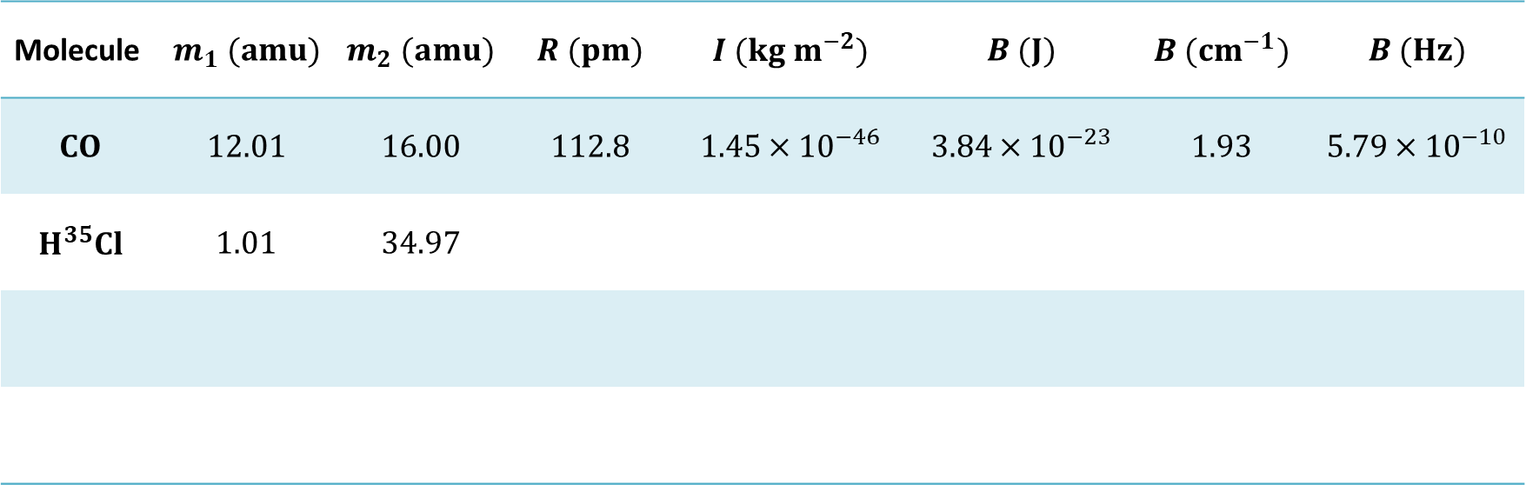

Ex. Fill in the table below. Last row for your preferred diatomic molecule.
Planck constant $h=6.626×{10}^{−24} m^{2} kg s^{−1}$
Atomic mass unit (amu) $=1.660×{10}^{−27} kg$
Speed of light $c=2.998×{10}^{10} cm s^{−1}$
Molecule | $$m_{1} (amu)$$ | $$m_{2} (amu)$$ | $$R (pm)$$ | $$I (kg m^{−2})$$ | $$B (J)$$ | $$B (cm^{−1})$$ | $$B (Hz)$$
$$CO$$ | $$12.01$$ | $$16.00$$ | $$112.8$$ | $$1.45×{10}^{−46}$$ | $$3.84×{10}^{−23}$$ | $$1.93$$ | $$5.79×{10}^{−10}$$
$$H^{35}Cl$$ | $$1.01$$ | $$34.97$$

Slide 21

Activity 0: Stand up and stretch!
Vibrations

Slide 22





Vibration of a diatomic molecule
$$T=\frac{1}{2}μ{\dot{x}}^{2}=\frac{p^{2}}{2μ}$$
Kinetic energy:
$$m_{1}$$
$$m_{2}$$
Potential energy:
$$V=\frac{1}{2}kx^{2}=\frac{1}{2}μω^{2}x^{2}$$
Put in SE and solve …
$$E_{vib}=ℏω\left(v+\frac{1}{2}\right)$$
Vibrational quantum number$v=0,1,2,…$

Slide 23




Vibration Energy Transitions
Vibration Quantum number:
$$v=0, 1, 2, 3,…$$
$$E_{vib}=E_{v}=ℏω\left(v+\frac{1}{2}\right)$$
Vibration Energy levels:
Selection Rule:
$$Δv=±1$$
$$hf=ΔE=E_{v+1}−E_{v}=ℏω\left(v+1+\frac{1}{2}\right)−ℏω\left(v+\frac{1}{2}\right) \\ =ℏω$$
Energy of photon absorbed/emitted:
Just 1 line? So boring?

Slide 24


Vibration Energy Transitions
Vibration Quantum number:
$$v=0, 1, 2, 3,…$$
$$E_{vib}=E_{v}=ℏω\left(v+\frac{1}{2}\right)$$
Vibration Energy levels:
Selection Rule:
$$Δv=±1$$
$$hf=ΔE=E_{v+1}−E_{v}=ℏω\left(v+1+\frac{1}{2}\right)−ℏω\left(v+\frac{1}{2}\right) \\ =ℏω$$
Energy of photon absorbed/emitted:
Transitions across vibrational levels are typically accompanied by a change in rotational level.
$$Δv=±1, ΔJ=±1$$

Slide 25


















Ro-Vibration Transitions
P- Branch
R- Branch
$$J=9$$
$$J=9$$
$$ΔJ=−1$$
$$ΔJ=+1$$
$$J=8$$
$$J=8$$
$v=$3
$$J=7$$
$$J=7$$
$$J=6$$
$$J=6$$
$$J=5$$
$$J=5$$
$$v=2$$
$$J=4$$
$$J=4$$
$$J=3$$
$$J=3$$
$$J=9$$
$$J=9$$
$$v=1$$
$$J=8$$
$$J=8$$
$$J=7$$
$$J=7$$
$$J=6$$
$$J=6$$
$$v=0$$
$$J=5$$
$$J=5$$
$$J=4$$
$$J=4$$
$$J=3$$
$$J=3$$

Slide 26

Ro-Vibration Transitions
Ex. Examine the ro-vibrational spectrum of HCl closely.
Explain the features you see.

Slide 27

IR spectrum of a massive young stellar object AFGL4176 taken with the ISO. Note the characteristic P- and R- branches of the rovibrational spectrum of gaseous carbon monoxide.
Image taken from E. F. van Dishoeck et al., 1998, ASP Conf. Ser., 132, 54

Slide 28
Activity: “Seeing” IR absorption
Carbon dioxide gas in
V
Infra-Red lamp
IR detector and readout
Gas out

Slide 29


Microwave spectroscopy of TMC-1. Peaks corresponds to rotational transitions of molecules in TMC-1.
Ex. Identify peaks that correspond to the same molecular species. Estimate the rotational constants.
Taken from M. Ohishi, N. Kaifu, Faraday Discuss, 109, 205 (1998)

Slide 30


Slide 31


From M. Ohishi, N. Kaifu, Faraday Discuss, 109, 205 (1998)

Slide 32


B68 @ mm-wavelengths
Optical
3.22 mm
Spectroscopy becomes imaging.
This is applicable to other fields!
2.73 mm
3.06 mm

Slide 33
Activity: Sunset in a glass
Water +
a few drops of milk
White light
Notes:
For tutorial

Slide 34
Who ate the stars?!
Bok Gobule B68
The Scream, Edvard Munch

Slide 35
The Interstellar Medium (ISM)
Astronomers’ classification:
Emission nebula
Reflection nebula
Dark nebula
Planetary nebula
Astro-chemists’ classification:
Diffuse molecular clouds
Giant molecular clouds
Circumstellar medium

Slide 36
Physical conditions of the ISM
Location | Temperature | Number density
Diffuse clouds | ~ 100 K | ~ 100 cm⁻³
Giant molecular clouds | 10 – 100 K | 10⁴ – 10⁸ cm⁻³
Earth, atmospheric conditions | 300 K | 10¹⁹ cm⁻³
Earth, high vacuum chamber | 1 K – 1000 K | 10⁷ – 10¹⁰ cm⁻³
Ex. What does the physical conditions imply about the type of molecules that form in the ISM?

Slide 37
Rotations and Vibrations

Slide 38






Rotation $\vec{ω}=\frac{1}{r^{2}}(\vec{r}×\vec{v}) , \vec{L}=\vec{r}×\vec{p}$
1-body, around an axis
Moment of Inertia: A body’s resistance towards change in rotation motion
$$\vec{ω}$$
$$I=mr^{2}$$
$$\vec{v}$$
$$\vec{L}=\vec{r}×\vec{p} \\ =m\vec{r}×\vec{v} \\ =mr^{2}\frac{\vec{r}×\vec{v}}{r^{2}} \\ =I\vec{ω}$$
$$\vec{r}$$

Slide 39







Rotation $ω=\frac{v}{r} , L=mrv=Iω$
1-body, around an axis
$$ω$$
$$I=mr^{2}$$
$$v$$
$$L=Iω$$
$$r$$
$$T=\frac{1}{2}mv^{2}=\frac{1}{2}Iω^{2}$$

Slide 40










Rotation of 2 masses joined by a rigid (massless) rod about centre of mass
Distance from COM to mass 1: $r_{1}$
Centre-of-mass
Distance from COM to mass 2: $r_{2}$
$$m_{2}$$
Distance of separation:
$$R=r_{1}+r_{2}$$
$$m_{1}$$
About the centre-of-mass:
$$r_{2}$$
$$m_{1}r_{1}=m_{2}r_{2}$$
$$r_{1}$$
$$R$$

Slide 41







Ex. Use Eqs. (4.7) and (4.8) to derive Eqs. (4.8) and (4.9)
$r_{1}+r_{2}=R$ (4.7)
$m_{1}r_{1}=m_{2}r_{2}$ (4.8)
$r_{1}=\frac{m_{2}}{m_{1}+m_{2}}R$ (4.9)
$r_{2}=\frac{m_{1}}{m_{1}+m_{2}}R$ (4.10)
$$r_{1}+\frac{m_{1}}{m_{2}}r_{1}=R \\ r_{1}\left(1+\frac{m_{1}}{m_{2}}\right)=R \\ r_{1}\left(\frac{m_{2}+m_{1}}{m_{2}}\right)=R$$
$$r_{1}=\frac{m_{2}}{m_{1}+m_{2}}R$$
Similarly for $r_{2}$

Slide 42







Rotation of 2 masses joined by a rigid (massless) rod about centre of mass
Centre-of-mass
$$ω$$
Moment of inertial about COM:
$I=m_{1}r_{1}^{2}+m_{2}r_{2}^{2}$
$$m_{2}$$
$=m_{1}$ ${\left(\frac{m_{2}}{m_{1}+m_{2}}R\right)}^{2}+m_{2}$ ${\left(\frac{m_{1}}{m_{1}+m_{2}}R\right)}^{2}$
$$m_{1}$$
$$=μR^{2}$$
$$r_{2}$$
$$r_{1}$$
$$R$$
“Effective” mass: $μ=\frac{m_{1}m_{2}}{m_{1}+m_{2}}$
$$m_{1}r_{1}=m_{2}r_{2}$$
$$R=r_{1}+r_{2}$$

Slide 43






Rotation of 2 masses joined by a rigid (massless) rod about centre of mass
Moment of inertial $I$ about COM:
Centre-of-mass
$$ω$$
$$I=μR^{2}$$
$$m_{2}$$
Angular momentum $L$ about COM:
$$L=Iω$$
Kinetic energy
$$m_{1}$$
$$r_{2}$$
$$T=\frac{1}{2}Iω^{2}=\frac{L^{2}}{2I}$$
$$r_{1}$$
$$R$$
$$m_{1}r_{1}=m_{2}r_{2}$$
Potential energy
$$R=r_{1}+r_{2}$$
$$V=0$$

Slide 44







Recall: Restoring force / Harmonic Oscillator
$$F=m\ddot{x}=−kx$$
Image: Flaticon.com
$$\frac{d^{2}x}{dt^{2}}=−ω^{2}x$$
$${, w}^{2}=\frac{k}{m}$$
$${x\left(0\right)=x}_{0}$$
$$v\left(0\right)=0$$
$$x=x_{0}\cos{ωt}$$

Slide 45




Vibration of 2 masses joined by a (massless) spring
$$m_{1}$$
$$m_{2}$$
Equivalent to a particle (effective mass $μ$) on a spring (spring constant $k$):
Derivation in lecture note (Appendix)
$$\ddot{x}=\frac{d^{2}x}{dt^{2}}=−ω^{2}x, where ω^{2}=\frac{k}{μ}$$
Harmonic Oscillator:
$$, μ=\frac{m_{1}m_{2}}{m_{1}+m_{2}}$$
Here, $x$ is the amount of extension of the spring.

Slide 46




Vibration of 2 masses joined by a (massless) spring
$$m_{1}$$
$$m_{2}$$
$$\ddot{x}=\frac{d^{2}x}{dt^{2}}=−ω^{2}x, where ω=\sqrt{\frac{k}{μ}}$$
Harmonic Oscillator:
$$μ=\frac{m_{1}m_{2}}{m_{1}+m_{2}}$$
$$T=\frac{1}{2}μv^{2}=\frac{p^{2}}{2μ}$$
Kinetic energy:
Potential energy:
$$V=\frac{1}{2}kx^{2}=\frac{1}{2}μω^{2}x^{2}$$

Slide 47




Bonds = Sharing of electrons = Molecular Orbitals

Slide 48

Electronic Transitions across Molecular Orbitals
Typical energy difference between electronic energy states falls in the UV-vis range.
Accounts for the colour of molecules.
Why are leaves green?
UV-Vis absorption of Chlorophyll molecules
Source: Milne, B. F. et. al. Angew. Chem. Int. Ed. 2015, 54, 2170

